Slide 1
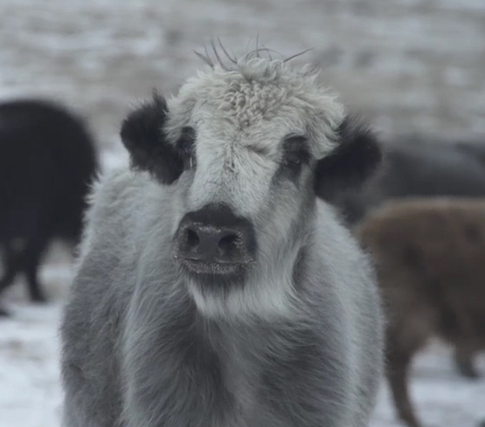
LTS-2 System
Exploratory Analysis of Service Usage
Over Time and Space

Slide 2


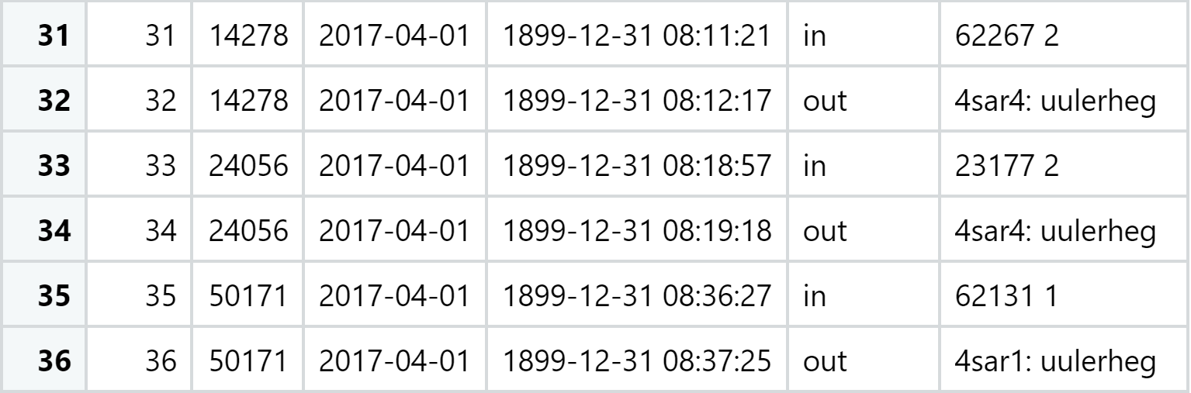
Area code and requested forecast
Weather or pasture forecast

Slide 3
Individual User
General Trends in System Usage Over Time
Spatial Distribution of Usage

